Slide 1

Risk Assessment Software
Malihe Goli
8-11-2022

Slide 2
SpiraPlan by inflectra
Key Features in SpiraPlan

Slide 3
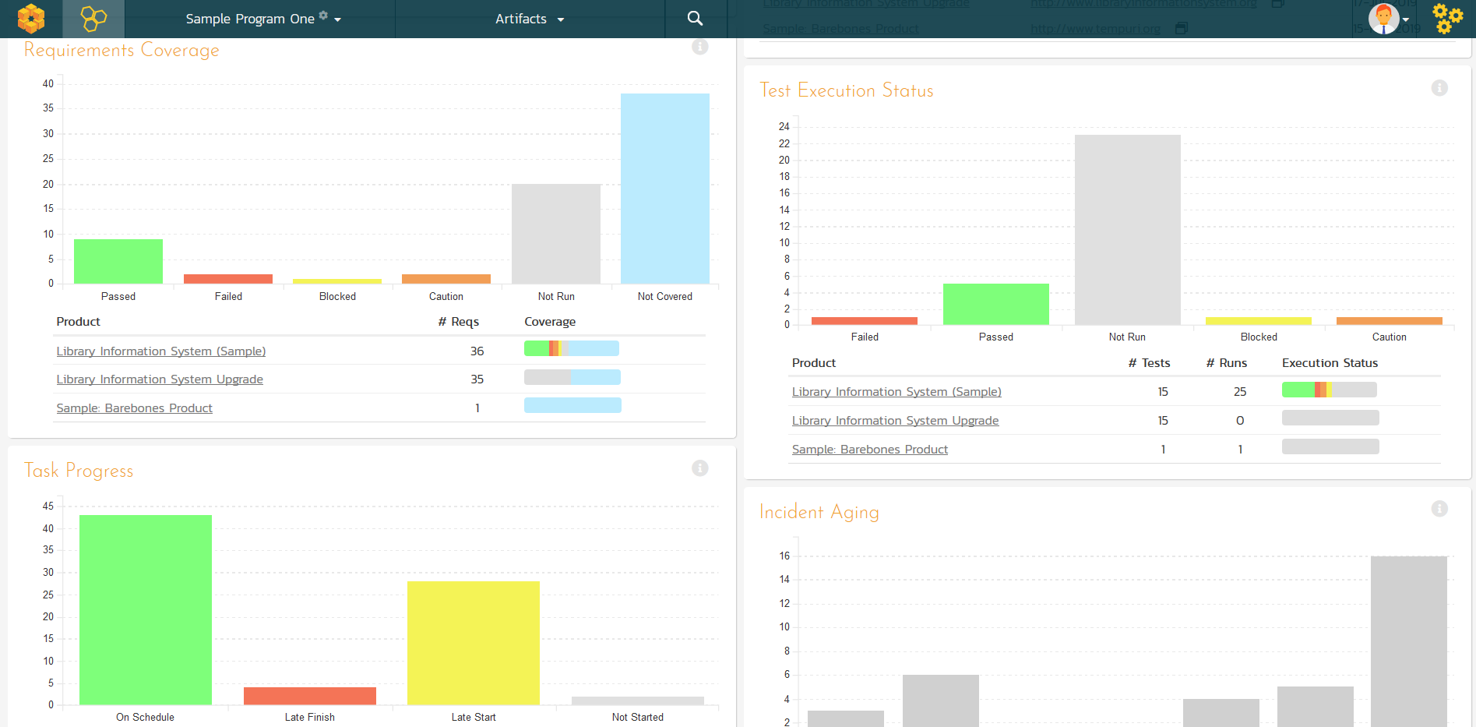
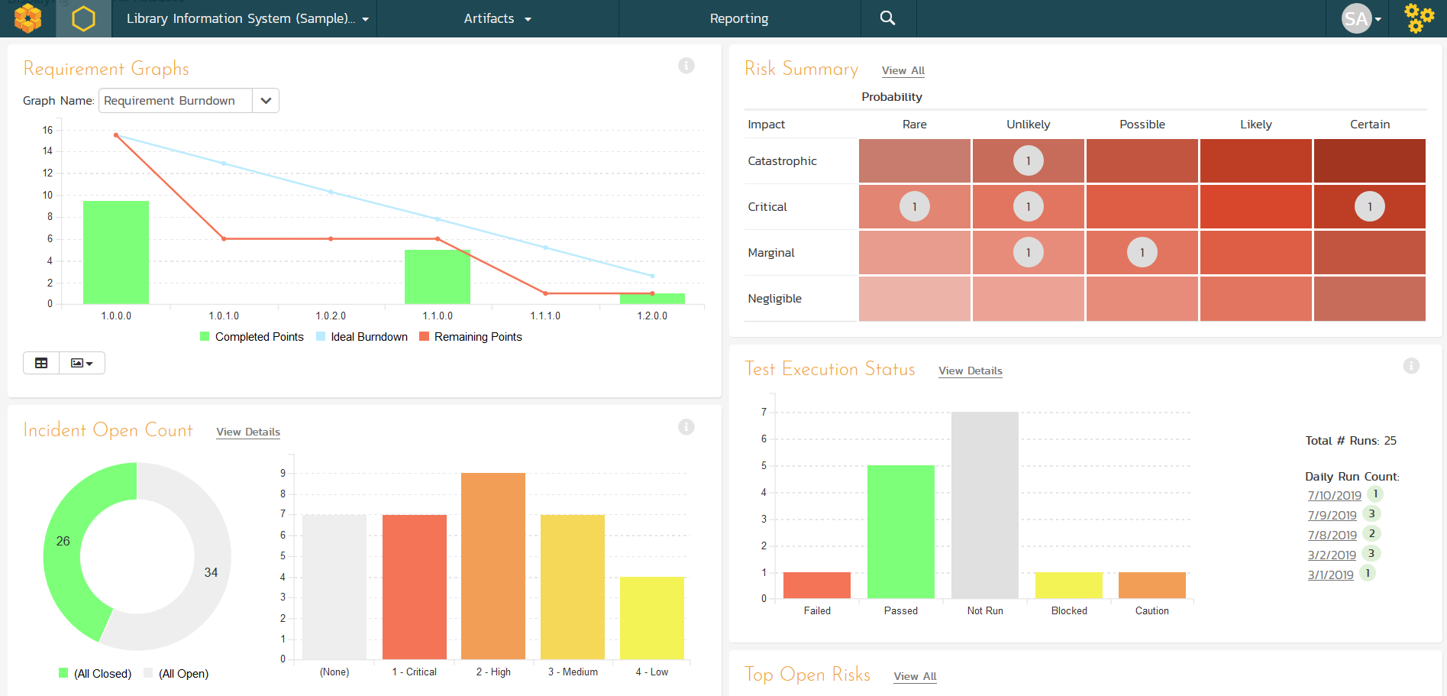
Program & Project Dashboards
Customizable reporting dashboards at the program, product, project, release and sprint levels

Slide 4
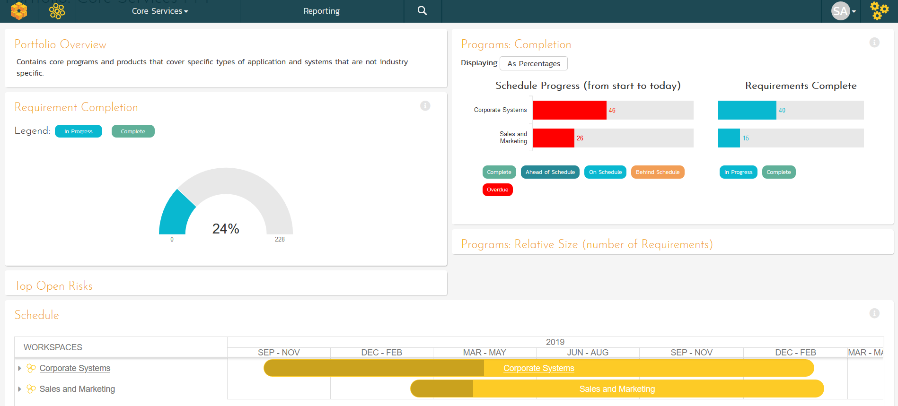
Portfolio Management & Roadmapping
Project Portfolio Management (PPM) dashboards

Slide 5
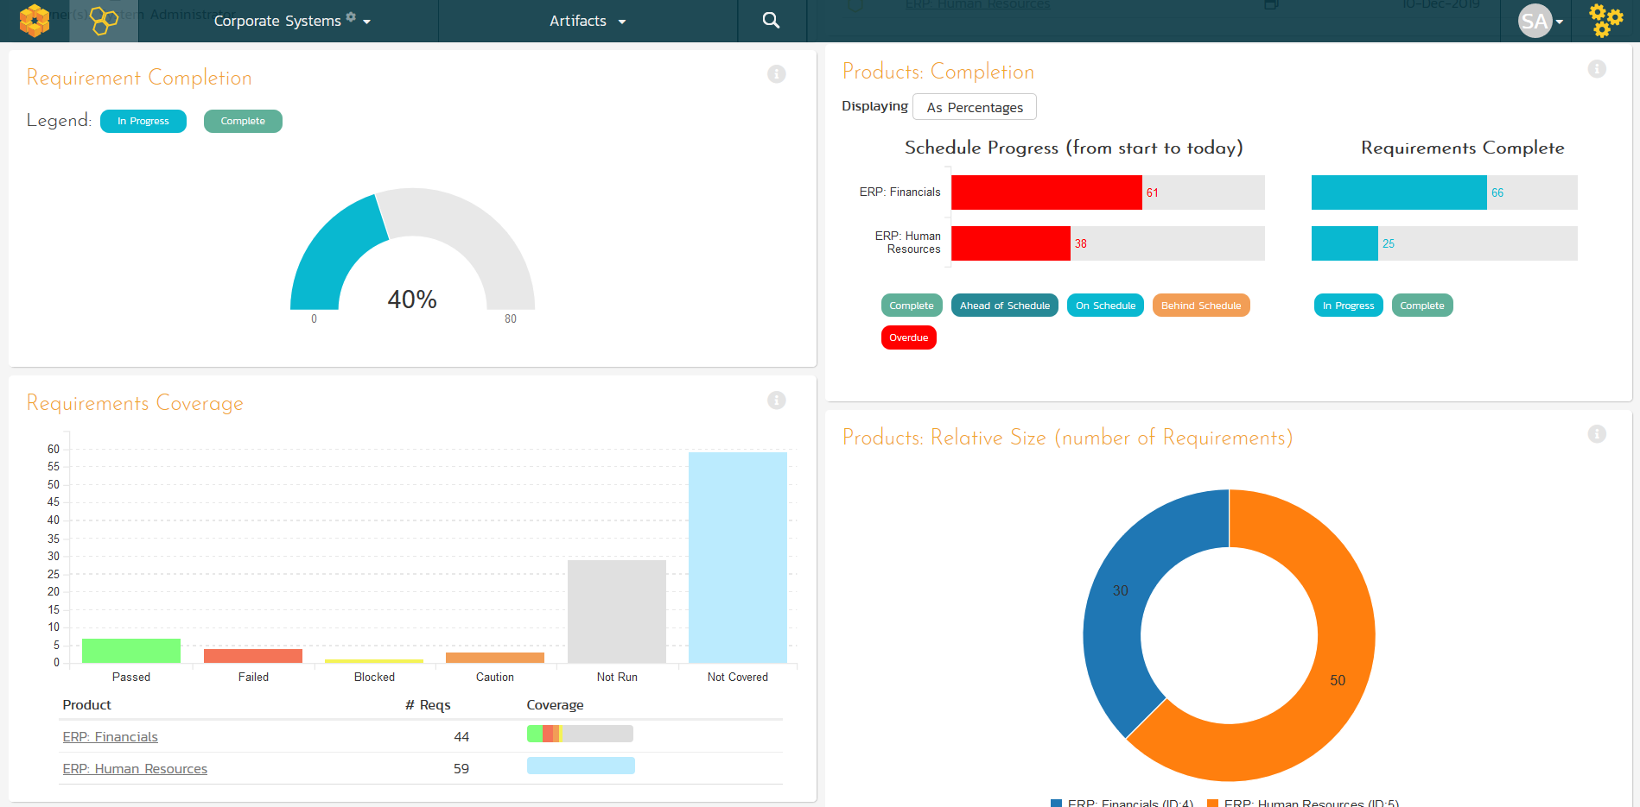
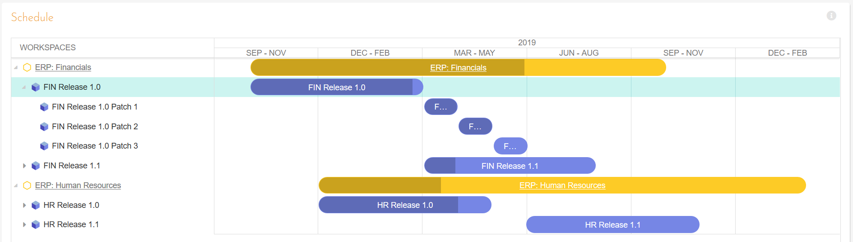
Program Management
Program planning and program management with integrated dashboards and program roadmaps.

Slide 6
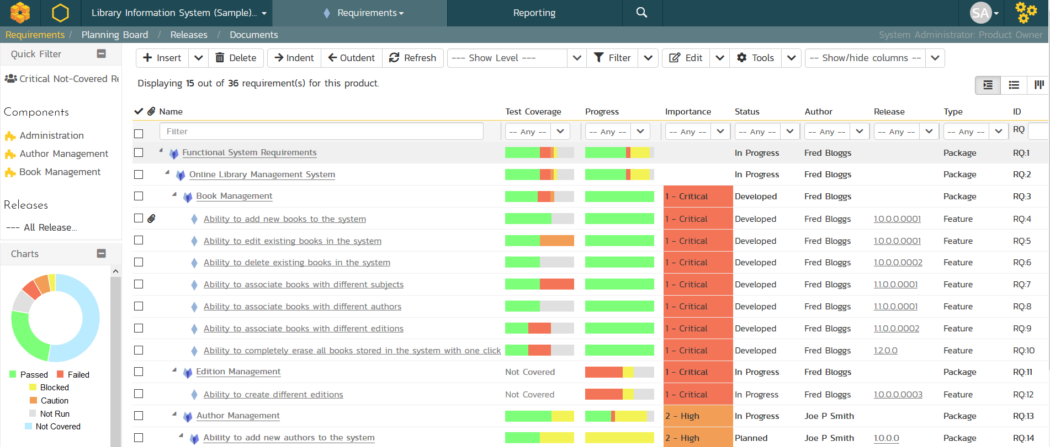
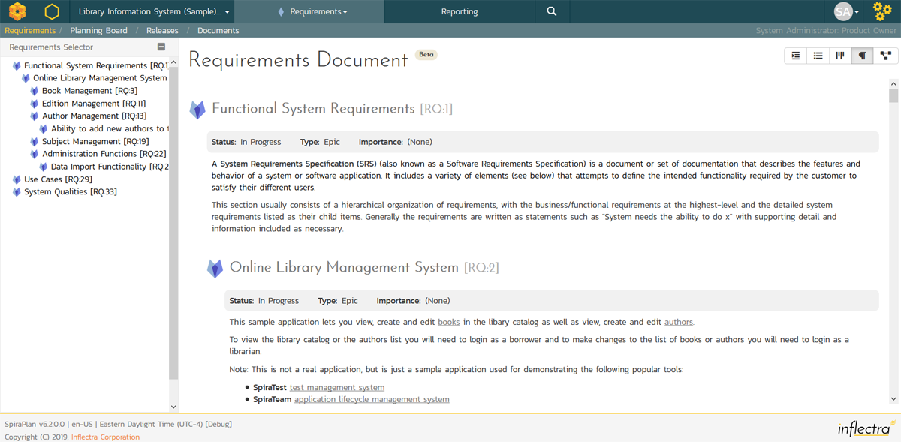
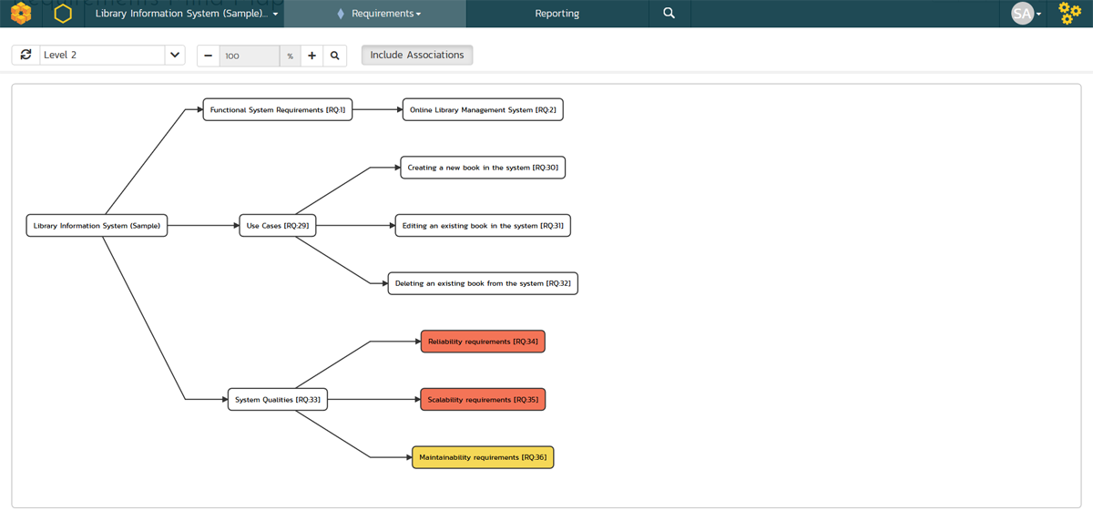
Requirements Management
Requirements management with end-to-end traceability

Slide 7
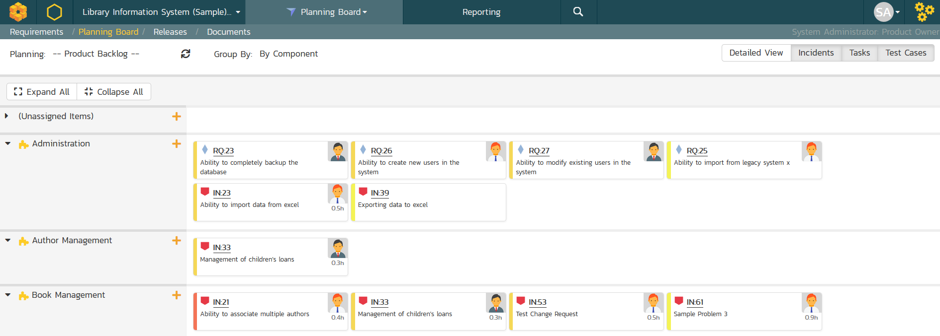
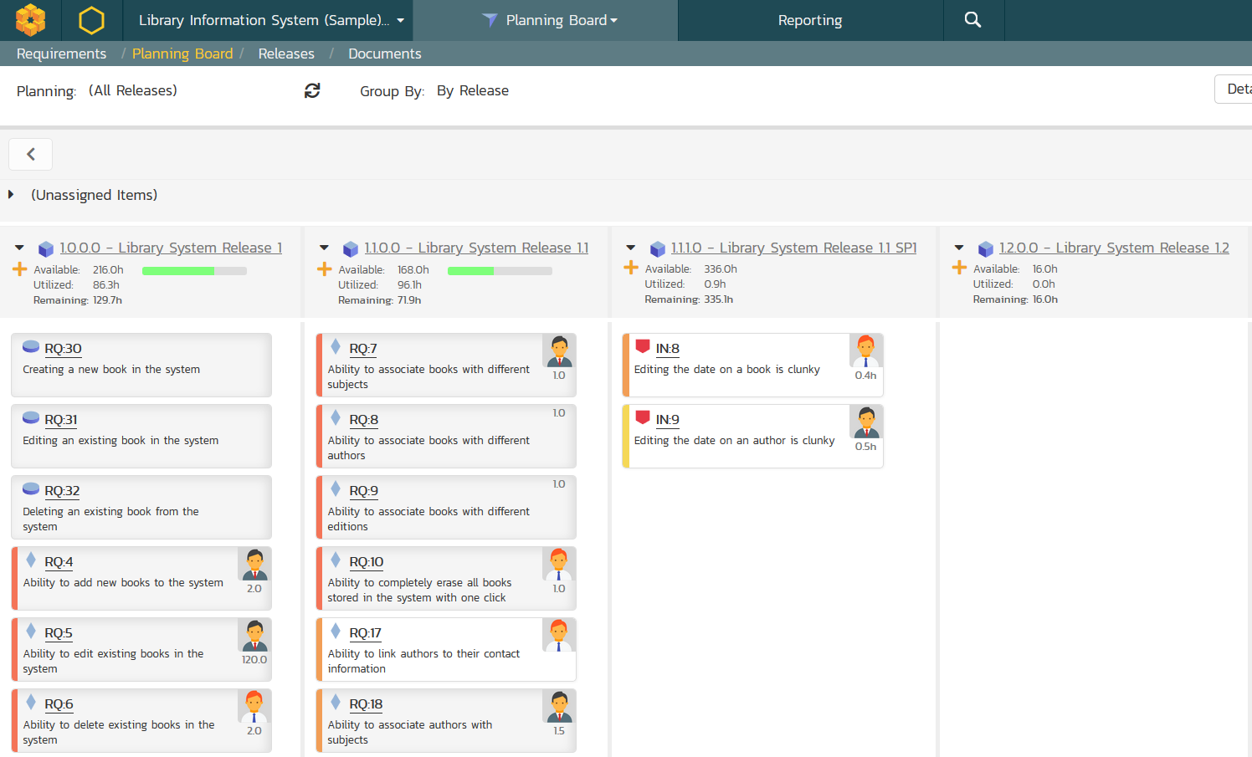
Agile Project Planning
Agile planning boards with test and task traceability that support multiple methodologies including Scrum and Kanban.

Slide 8
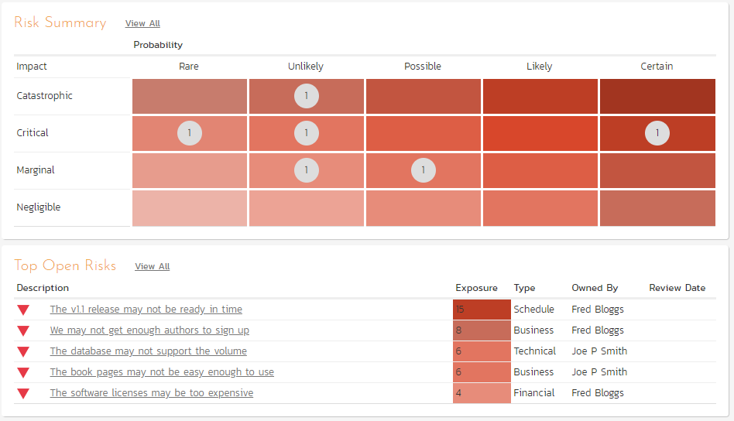
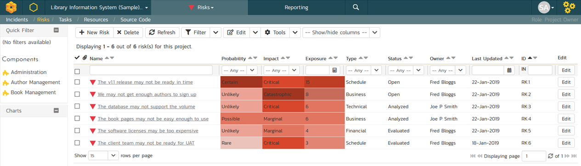
Risk Management
Manage your product and program risks, and track mitigations and action items. Automated exposure calculations out of the box.

Slide 9
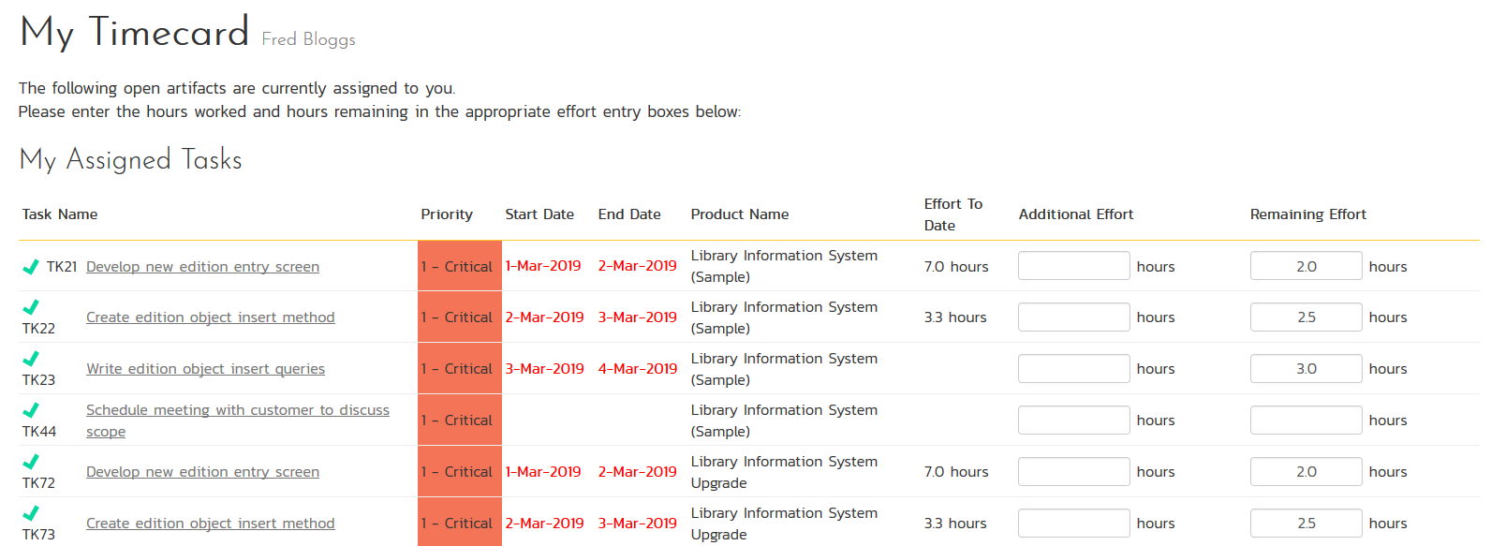
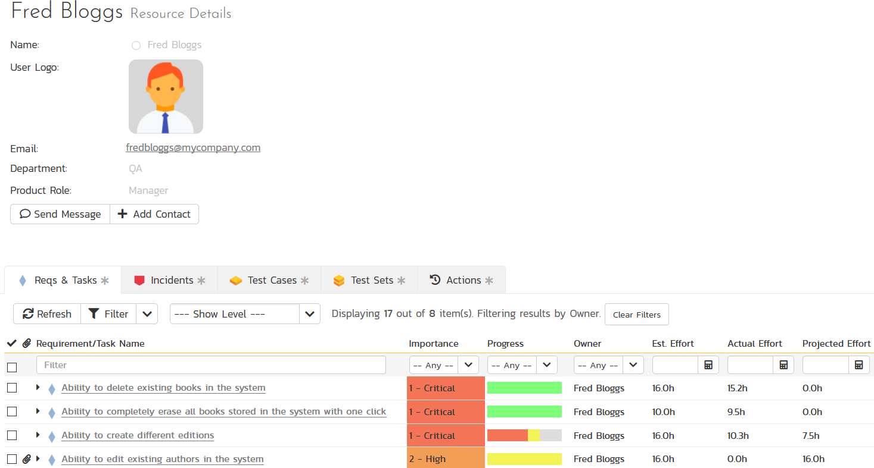
Resource Management
Manage the people and teams on your projects with centralized timecard submission and resource planning.

Slide 10
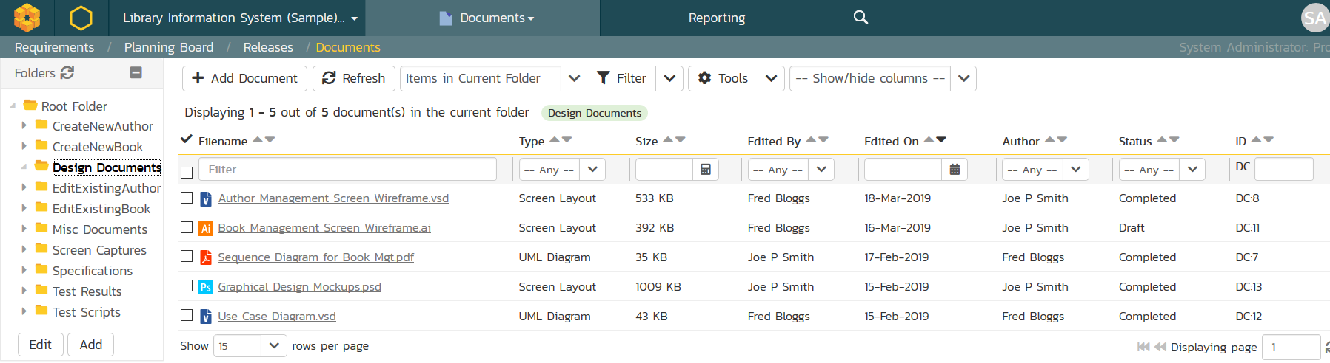
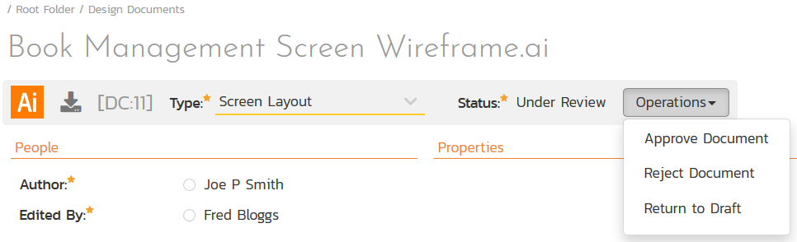
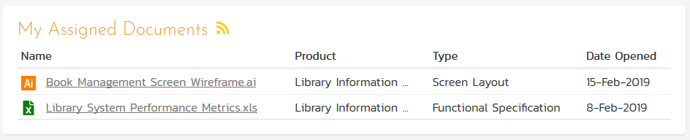
Document Management
Complete integrated document management system with versioning, check-in/out, and approval workflows.

Slide 11
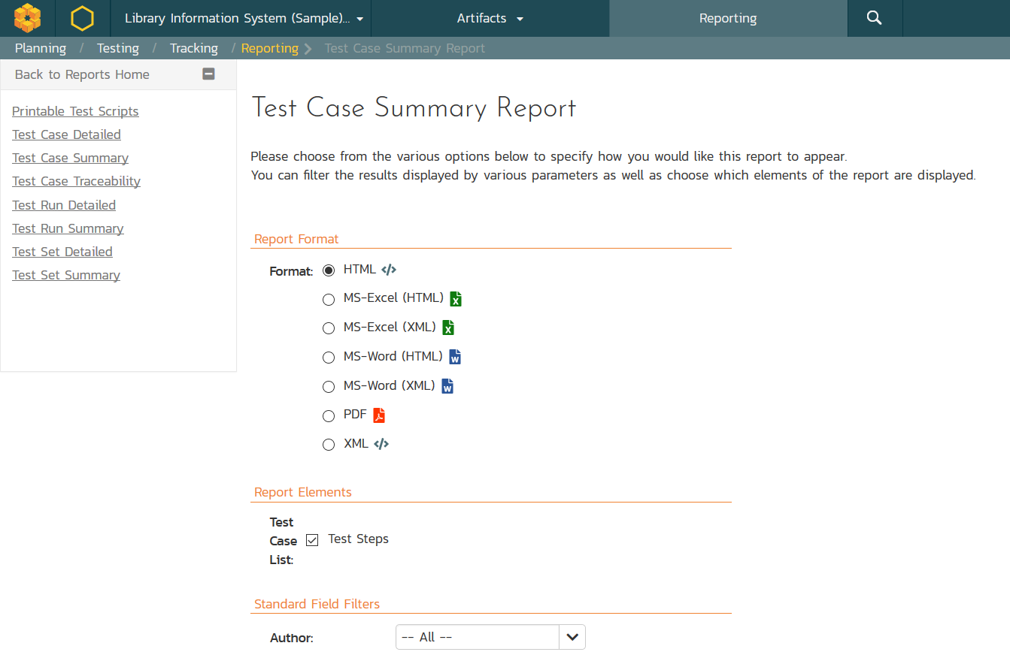
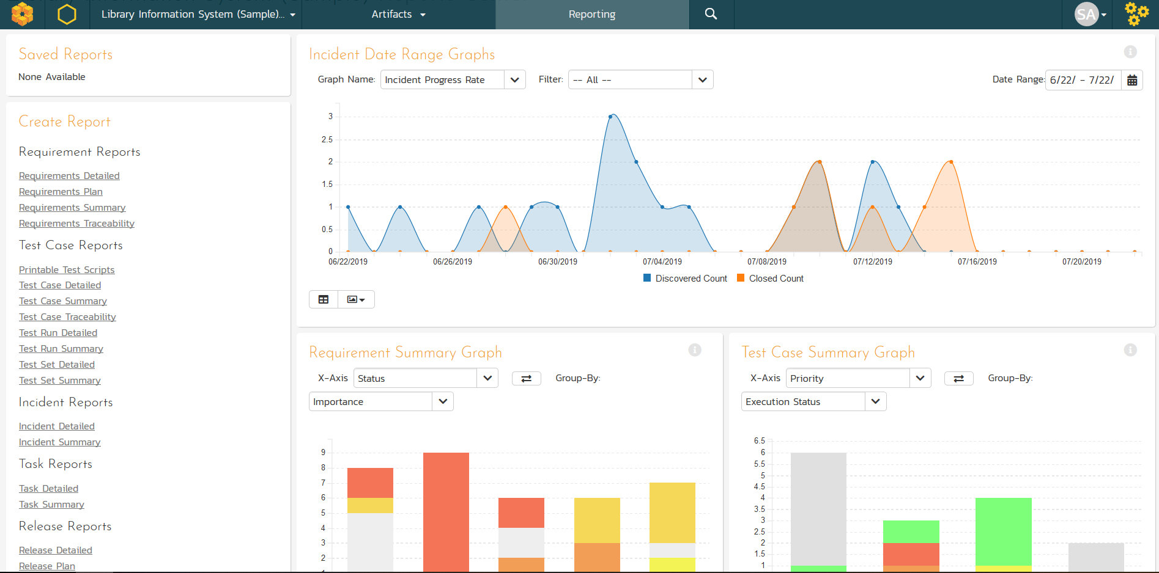
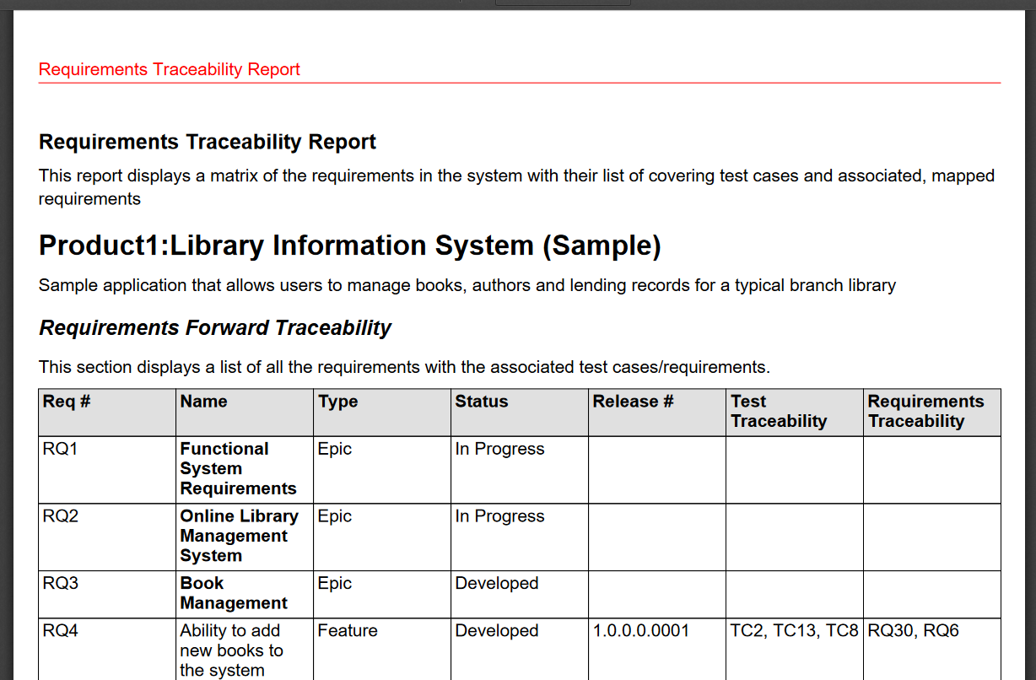
Customizable Reporting
Library of standard and custom reports, exported in various formats including Word, PDF, Excel, and PDF

Slide 12
ISOMetrix by Lumina
Key Features in ISOMetrix

Slide 13
Environmental, Social, and Governance (ESG) Management Solution
Notes:
Managers, our third pillar, could always take advantage of our reporting, dashboards, and traceability features. But we knew we could do a lot more to help managers – both senior leaders and those in other roles like BI

Slide 14
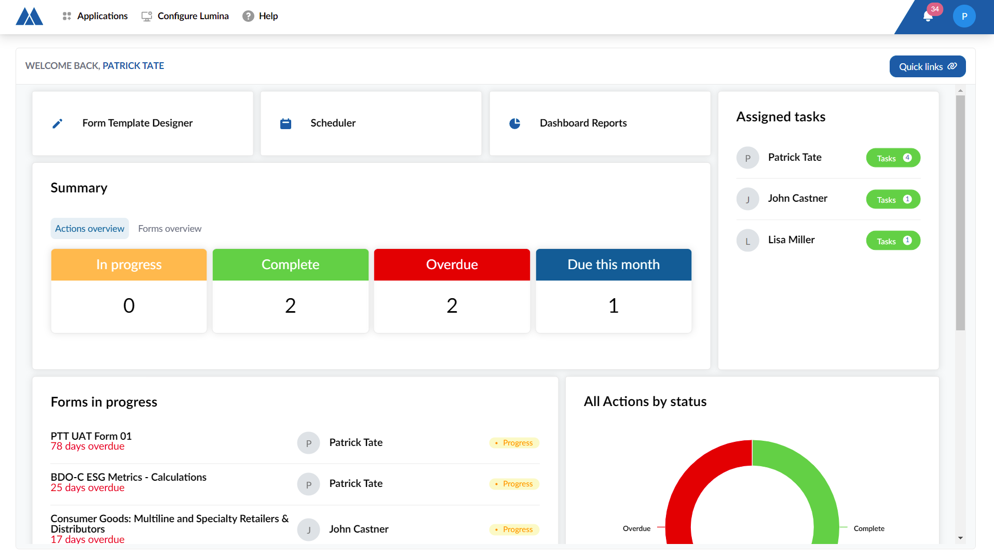
Oversee and manage all permits
Identify all safety hazards
Mitigate inherent risks
Manage the social fallout
Assess all environmental aspects and impacts.
Notes:
Oversee and manage all permits required to initiate and conduct a mining operation.
Identify all safety hazards and ensure that the inherent risks are mitigated.
Manage the social fallout as a result of any grievances or incidents.
Assess all environmental aspects and impacts

Slide 15
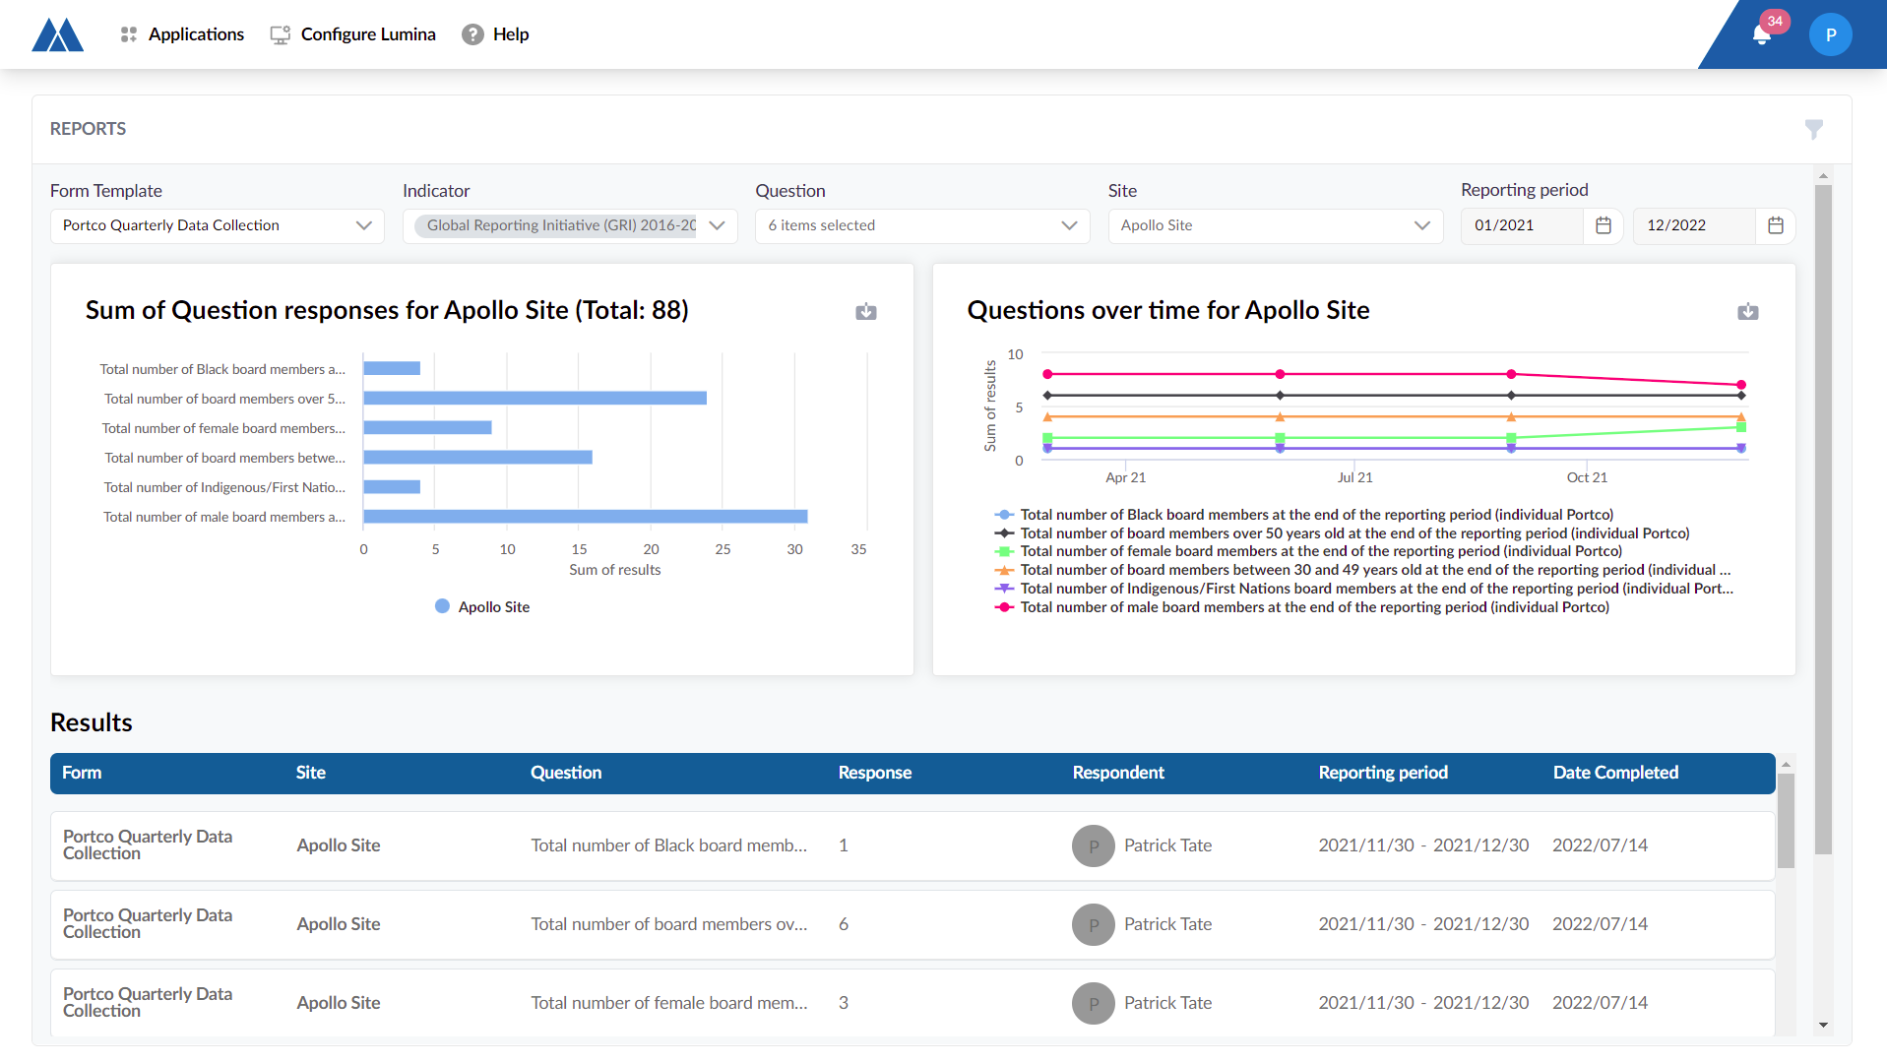
Manage all EHS risks and critical controls
ESG data can be gathered, calculated, analyzed, and reported on.
Tailings facility aspects can be tracked
Notes:
Manage all EHS (Environmental Health & Safety) risks and critical controls through an integrated risk process, conduct audits, and inspections, and monitor environmental and social impacts.
ESG data can be gathered, calculated, analyzed, and reported on. Tailings facility aspects can be tracked to achieve compliance and minimize incidents.

Slide 16
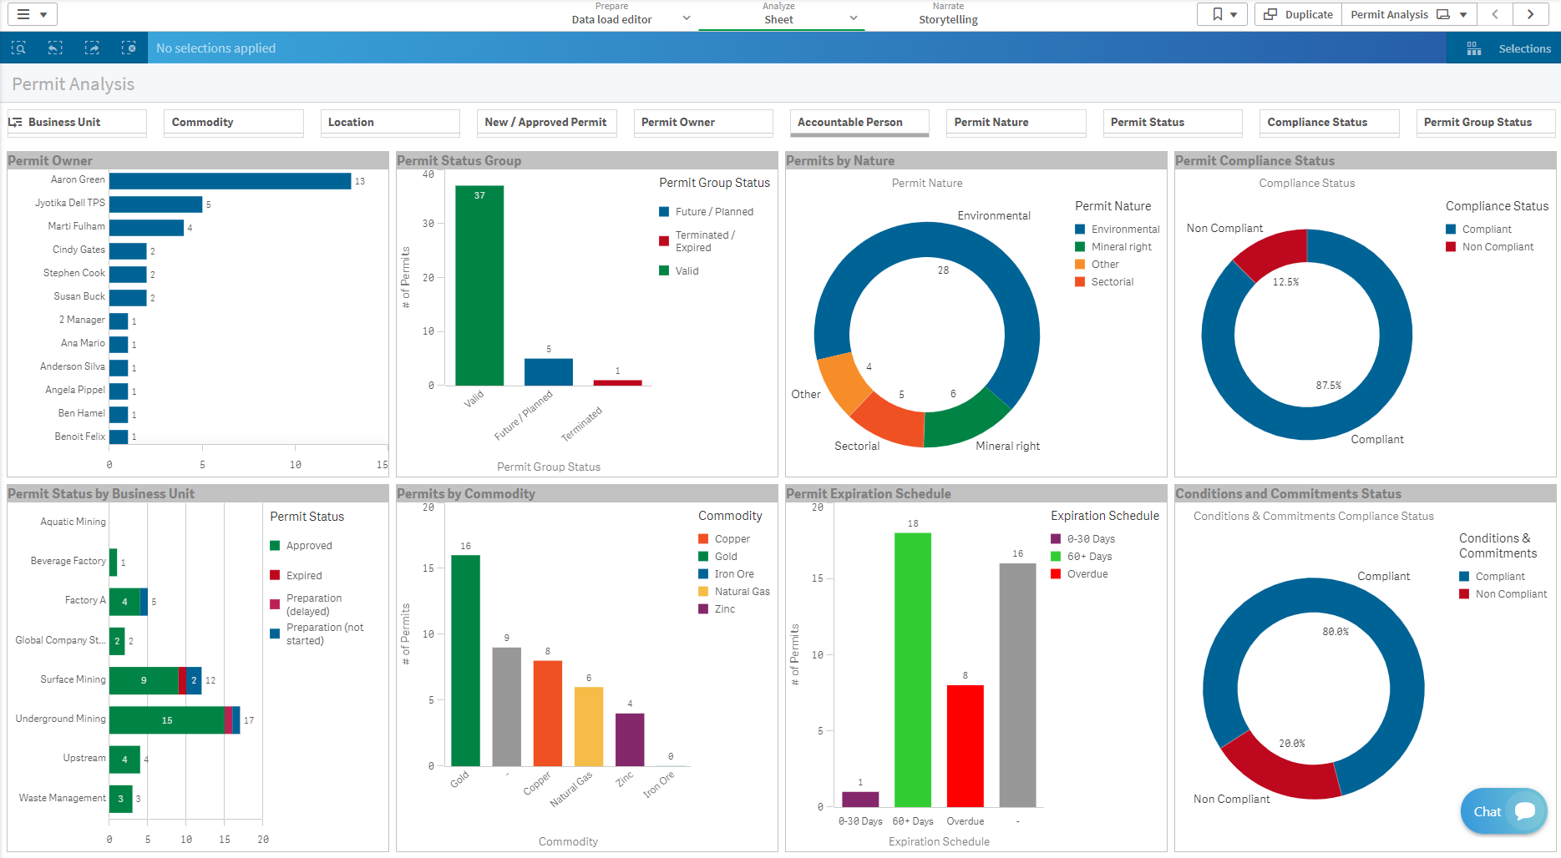
Enterprise Risk Management for Transportation

Slide 17
RMStudio
Systems-Theoretic Process Analysis (STPA)

Slide 18
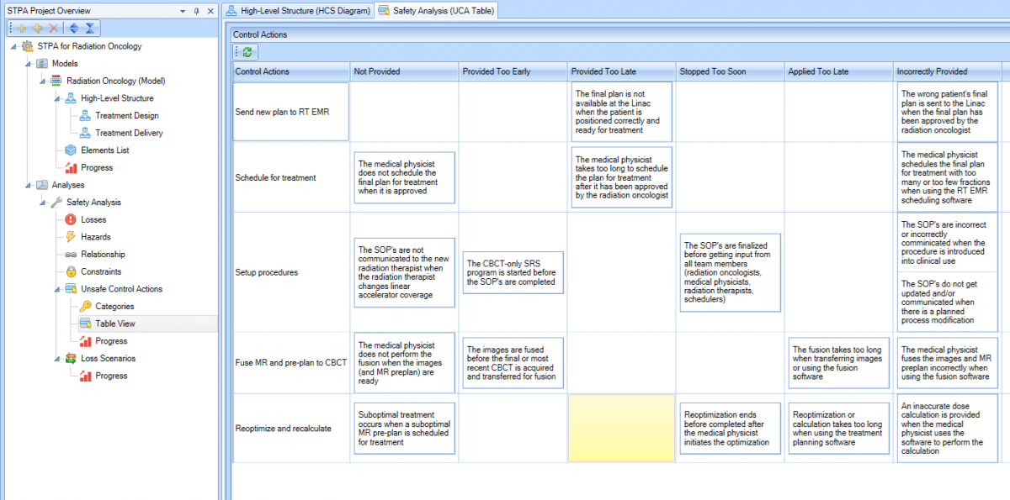
The RM Studio STPA module

Slide 19
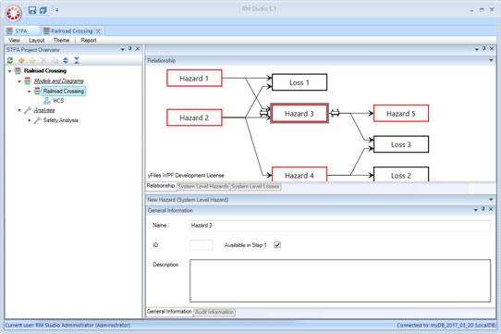
Hazard Diagram

Slide 20
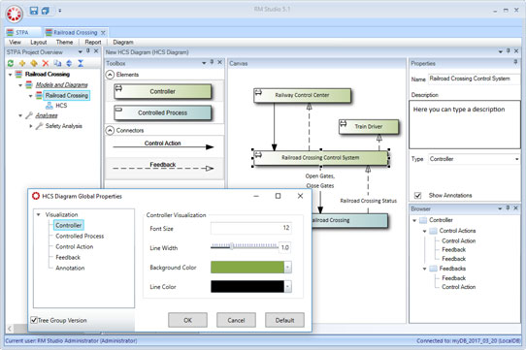
The HCS Diagram
Notes:
Hazard Communication Standard and
The hierarchy of control is a system for controlling risks in the workplace. The hierarchy of control is a step-by-step approach to eliminating or reducing risks and it ranks risk controls from the highest level of protection and reliability through to the lowest and least reliable protection.

Slide 21
Questions?

